Slide 1

Making A Presentation

Slide 2
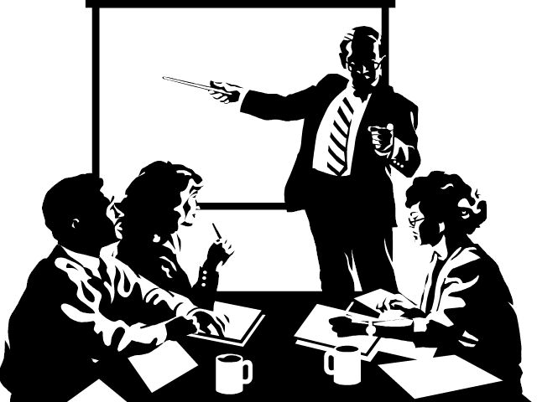
Most English Presentations follow the same template

Slide 3

1. The beginning is short
2. Tell the audience what your topic and main message is
3. Give your audience a brief overview of your main points or primary support

Slide 4

Let’s learn some key phrases:
Beginning | Phrases
Background | As you know As you may know As background
Subject | The subject of my presentation is The topic of my presentation is Today, I am here to talk about I would like to talk about
Purpose | The purpose of my presentation is The objective of my presentation is My key message is My objective this afternoon is My goal in the next fifteen minutes is to
Dividing your presentation into parts | I will talk about three main things: My presentation will be divided into three main points:

Slide 5
Let’s look at an example of a beginning:
How many of you here consider yourself caffeine addicts? How much coffee do you drink a day? One cup? Two cups? More? How about caffeinated sodas? As you may know Caffeine is pervasive in our society these days and every few months we hear about how a study has shown that it is bad for us or good for us. What are we to believe?
Today I would like to give you some of the facts about caffeine and its effects on your body. It may not cause you to change your coffee consumption but at least you’ll be better informed about what you are putting into your body and that’s the objective of my presentation. I’m going to talk about three main things: beneficial effects of caffeine, the negative effects and discuss what are considered safe levels of caffeine consumption.

Slide 6

1. Middle Section: Going detail
2. Each point should represent the main points you gave in your introduction.
3. After that, give secondary support with SAFER: stats,
anecdotes,
facts,
examples,
reasons

Slide 7

Let’s learn some key phrases::
Middle | Phrases
Moving from the beginning to the first point | Let me move onto my first point. First, …..
Second Point | In addition to ……………. My second point is ……….. Let me move onto my second point.
Final Point | My final point is Finally Third Last but not least,

Slide 8
Let’s look at an example of middle: The first primary support
Let me move onto my first point: the good news. Caffeine, which comes from the leaves, seeds and fruits of about 63 different plants, is well known as stimulant. That’s why people drink it, right? Caffeine does help you wake up and feel more alert and it has been shown to increase attention spans. This is a beneficial effect for people who are driving long distances and for people who are doing tedious work. Calling this a health benefit may be stretching it, though staying awake while you are driving a car is definitely a benefit to your well-being! Caffeine also contains antioxidants which have been shown to have cancer prevention qualities.

Slide 9
The second primary support:
Let me move onto my second point. The negative effects of caffeine are largely dependent on how much you consume. When consumed in small quantities like, for example when you have one cup of coffee or one cold drink, caffeine can cause your heart rate to increase, you urinate more which can cause dehydration, and your digestive system produces more acid. In larger amounts, caffeine can cause you to have headaches, feel restless and nervous, be unable to sleep, and even, in very large quantities to have hallucinations. (Don’t try that at home!) When larger amounts of caffeine (over 600 mg per day) are used over long periods of time you can develop sleep problems, get depressed and have problems with your digestive system.

Slide 10
The third primary support:
Last but not least, according to a Medline article on the National Institutes of Health website, having caffeine in your diet is not of any benefit to your health but moderate consumption is also not considered harmful. They say that having up to 3 eight ounce cups of coffee a day or 250 mg of caffeine is considered “average or moderate”. 10 cups of coffee a day is considered excessive. Also, remember that the amount of caffeine per cup can vary greatly depending on the type of beans that are used and the strength of the brew. Finally, the effect of caffeine on you personally will depend on a number of factors like your weight, general health, mood and personal sensitivity to caffeine.

Slide 11

1. The Ending: Short like the Beginning
2. Restate your topic and key message/ conclusion.
3. Do not bring up new things.
4. Thank the audience and ask for questions.

Slide 12
Let’s learn some key phrases:
Ending | Phrases
Signaling the end | Today, I have told you about Today, I have talked about In summary,
Showing benefits/ Next Steps | I recommend that you I suggest that you I encourage you to If you do that,
Thanking | Thank you very much. Are there any questions? Thank you for listening. Are there any questions? Thank you for coming. Are there any questions?

Slide 13
Let’s look at an example of Ending
In summary, you can see that caffeine can have both positive and negative effects on our health and well-being but the bottom line is that if you drink your coffee or cold drinks in moderation, you don’t have to worry to much. So, I recommend that the next time you are wondering whether you should have that second cup of coffee to perk you up, relax. At least now you know what it is and isn’t doing to you!
Thank you for coming. Are there any questions?

Slide 14
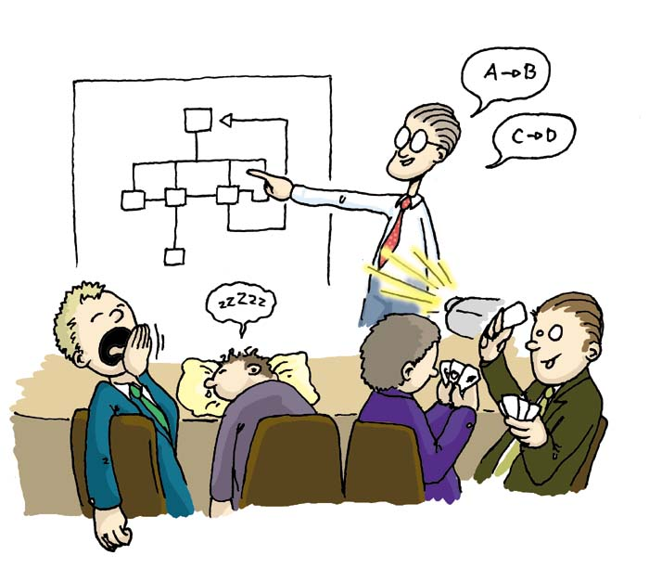
Thank you for listening. Are there any questions?

